Slide 1

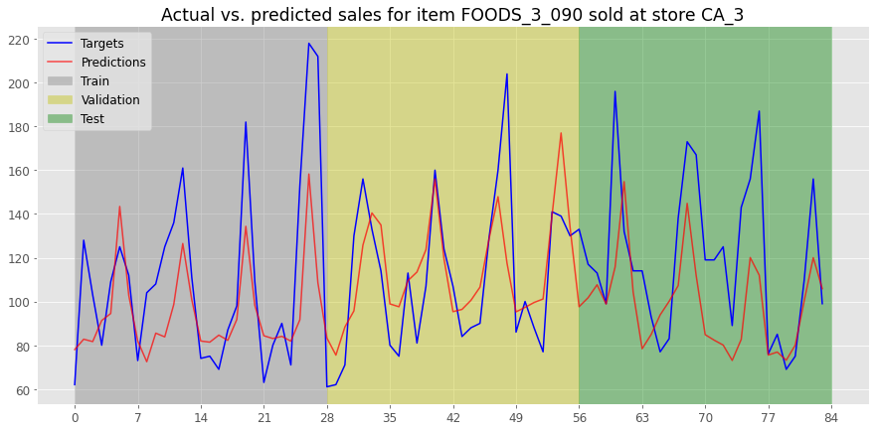
2019-2020 M.Sc. in Data Science and Analytics
Multi-Step Sales Forecasting of Walmart Products
Moeen Bagheri Supervisor: Dr. Konstantinos Georgiou
Objective
The aim is to provide 28-days ahead sale forecasts for 30490 items sold by Walmart. The objective is to compare the performance of deep learning models with machine learning models, the performance of recurrent neural networks with simple neural networks, and the performance of a hybrid model with its individual components.
Background
Forecasting future sales is important to retailers for managing inventory and making marketing decisions. However, the volatility in demand, which is dependent on many external factors, such as holidays, prices, and promotions, makes sales forecasting a challenging problem. Hence, it is necessary to consider the effects of these external factors when forecasting future sales.
Results
The LGBM model performed the best, followed by the LSTM-LGBM hybrid model.
The LSTM model outperformed the MLP model.
A LSTM-LGBM hybrid model was constructed, which was able slightly improve the performance compared to the LSTM model, but it was not able to outperform the LGBM model.
 | ME | RMSE | RMSSE
LSTM | -0.10991 | 2.27780 | 0.80511
MLP | -0.08568 | 2.29376 | 0.81075
LGBM | -0.07056 | 2.18648 | 0.77283
LSTM-LGBM | -0.11916 | 2.25698 | 0.79775
Methodology
Two experiments were performed:
Experiment 1:
The performances of three singular models, Long Short-Term Memory (LSTM), Multi-Layer Perceptron (MLP), and LightGBM (LGBM), were compared in predicting 28-days ahead sale forecasts.
In order to make the MLP and LGBM models look more than one step in the past, we created lag and rolling mean/std features of the sales values.
The hyperparameters of all three models were optimized using Bayesian optimization.
Experiment 2:
A hybrid model consisting of the LSTM model and the best performing model between the MLP and LGBM models was constructed and its performance was compared with the performances of its individual components.
The hybrid model was constructed in a sequential manner, where the LSTM model is first fitted to the sales time-series data and predicts the futures sales, and the second component is fitted to the residuals of the LSTM component, and predicts the error of the LSTM model based on the external factors.
All models were trained using the Root Mean Square Error (RMSE) as the loss function.
The models were evaluated using the Root Mean Square Scaled Error (RMSSE), by comparing their performances to the performance of a naïve model.
The Mean Error (ME) of each model was also evaluated to check whether the models tend to over-forecast or under-forecast the target sale values.
Conclusions
The performance of the LGBM model highlights the potential of boosting methods in improving the overall performance.
From the results of the LSTM and MLP models, we can clearly see the ability of LSTM models in working with time-series data compared to regular neural networks.
The performance of the hybrid model was closely tied to the performance of its first component.

